Slide 1

ENR Trains App Redesign: Improving User Experience Based on Real User Feedback
An HCI Project focused on enhancing the usability and accessibility of the Egyptian National Railways (ENR) mobile application.

Slide 2
Introducing the ENR App: A Vital Connection
The ENR app serves as a critical digital gateway for millions of users in Egypt, facilitating essential travel needs and significantly streamlining the traditional process of railway services. It offers:
Convenient online ticket booking and secure payment.
Real-time access to comprehensive train schedules and routes.
Efficient comparison tools for various train options.
Despite its undeniable value and integral role in daily commutes and long-distance travel, the current version of the app presents a number of significant usability challenges that hinder user satisfaction and adoption.

Slide 3
The Imperative for Redesign: Addressing Usability Gaps
Unclear Booking Process
Confusing Navigation
User Frustration
Users frequently report difficulties navigating the ticket booking flow, leading to confusion and abandoned transactions. The steps are often ambiguous and lack intuitive guidance.
The app's overall information architecture and navigation patterns are not always logical, making it hard for users to find specific features or information efficiently.
A high volume of negative feedback highlights widespread user frustration, indicating that the current design does not meet the basic expectations for a modern mobile application.
These core issues directly impact user engagement and the app's overall effectiveness, signaling a critical need for a comprehensive redesign rooted in Human-Computer Interaction (HCI) principles.

Slide 4
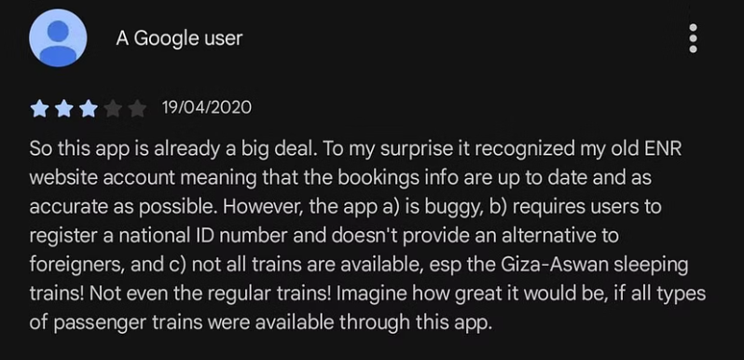
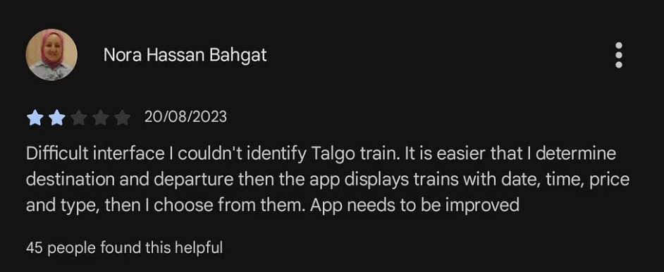
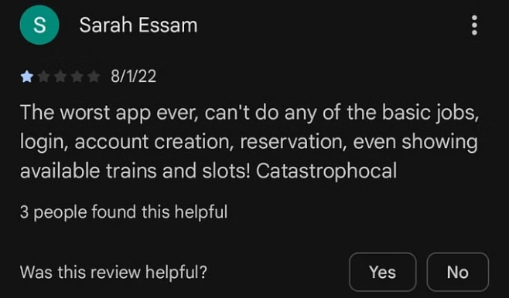
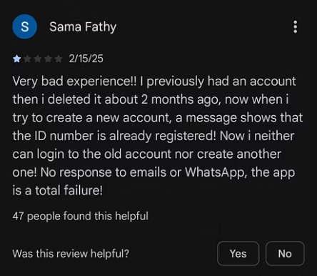
Echoes of Discontent: Real User Feedback
Direct insights from Google Play Store reviews consistently underscore the urgent need for improvements. Users voice concerns across several critical areas:
These candid testimonials reveal pain points ranging from initial sign-up hurdles and verification problems to an overly complex booking process, collectively painting a picture of a user experience ripe for enhancement.

Slide 5

Our User-Centered Redesign Approach
Our redesign methodology was strategically aligned to tackle identified usability issues and elevate the overall user experience. We focused on a user-centered design paradigm to ensure the solutions truly met user needs.
Simplifying User Journeys
Identifying Core Complaints
Streamlining complex tasks and interactions to create more intuitive and efficient workflows.
Thorough analysis of user reviews and feedback to pinpoint the most critical pain points.
Iterative Design & Testing
Applying HCI Principles
Developing prototypes and conducting user testing to refine the design based on real-world interaction.
Integrating established Human-Computer Interaction guidelines for consistency, feedback, and error prevention.
This comprehensive approach ensures that every change contributes to a more accessible, efficient, and enjoyable experience for all ENR app users.

Slide 6
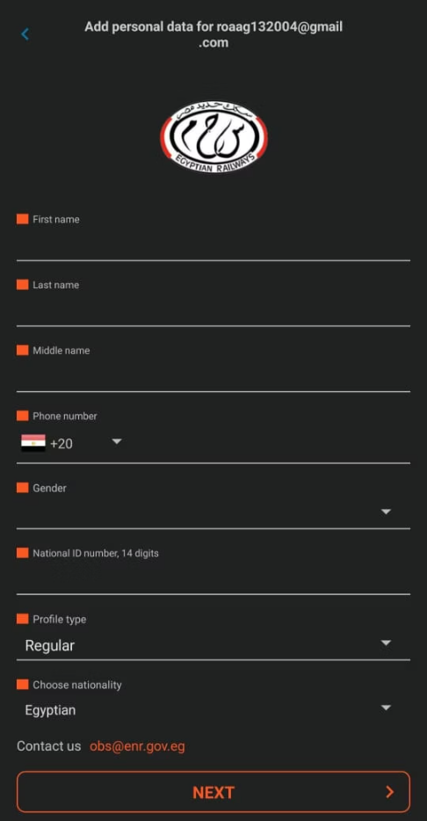
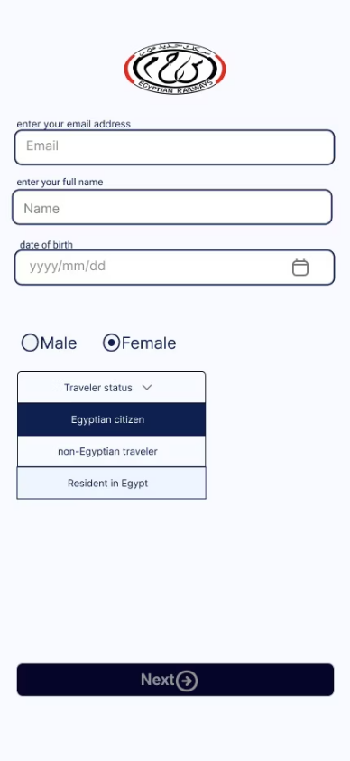
Challenge 1: Streamlining the Login Process
The Problem: Friction in First Impressions
Our Redesign: Seamless Access
The original app's login process presented significant hurdles:
To address these issues, we introduced a more user-friendly authentication system:
Exclusive reliance on email registration, often leading to longer sign-up times.
Google Account Integration: Allowing instant login with existing Google credentials.
A cumbersome, multi-step sign-up sequence that increased user drop-off rates.
Auto-Filled Data: Automatically populating user details where possible, reducing manual input.
This friction at the entry point created a poor first impression and discouraged new users.
The Benefit: Faster, Effortless Login
This redesign significantly reduces the time and effort required to access the app, leading to a smoother onboarding experience and increased user retention from the very first interaction.

Slide 7
Challenge 2: Expanding Accessibility for Non-Egyptian Users
The Problem
The original ENR app mandated a National ID for all transactions, effectively excluding a significant demographic:
International travelers and foreign residents were unable to utilize the app's services due to this strict requirement.
This limitation restricted the app's potential user base and hindered its ability to serve a diverse population.
Our Redesign
To foster inclusivity and broaden the app's reach, we implemented a more flexible identification system:
Dual Identification Options: Maintaining National ID for Egyptian citizens, while introducing Passport Number as an alternative for non-Egyptians.
Enhanced Passport Data Fields: Adding fields for issuing country and expiry date to ensure comprehensive and secure verification.
The Benefit
This critical update transforms the app from a national utility to a globally accessible service, directly leading to:
A substantial increase in the overall user base.
Enhanced profitability through expanded market reach.
A more welcoming experience for tourists and expatriates in Egypt.

Slide 8
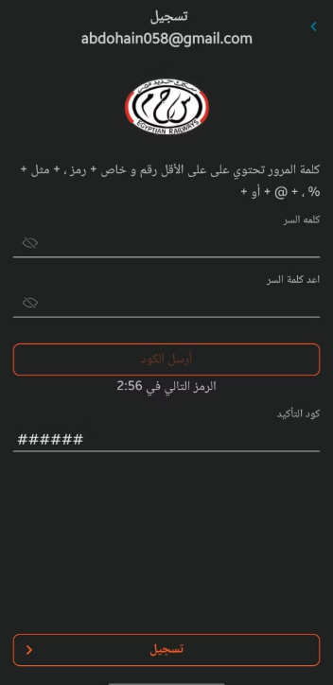
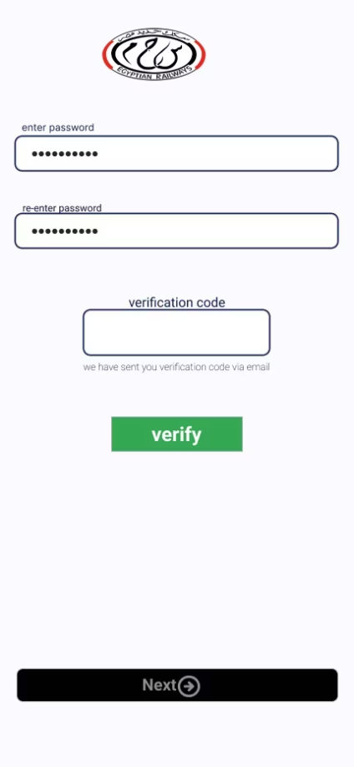
Challenge 3: Resolving Verification Code Issues
The Problem: A Barrier to Entry
Many users encountered significant frustration with the app's verification process:
Frequent problems receiving or entering verification codes.
Unclear or insufficient instructions on how to troubleshoot common issues.
Lack of immediate feedback, leaving users uncertain about the next steps or errors.
These verification roadblocks often led to abandoned sign-ups or transactions.
Our Redesign: Clarity and Support
Our solution focused on improving communication and guidance:
Clearer Instructions: Providing concise, step-by-step guidance for code retrieval and entry.
Enhanced Feedback Messages: Implementing explicit error messages and success confirmations to inform users of their status.
The Benefit: Higher Success, Less Frustration
By clarifying the process and offering better feedback, we've achieved a higher success rate for verification, dramatically reducing user confusion and enhancing overall app reliability.

Slide 9
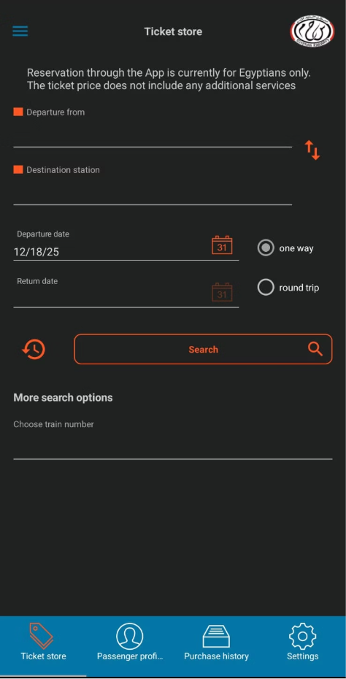
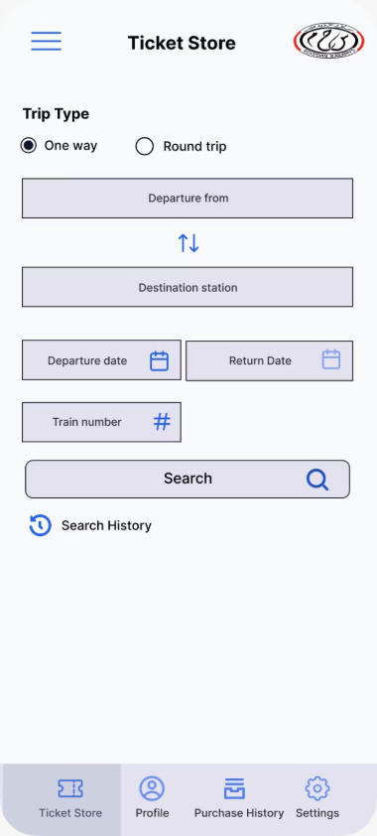
Challenge 4: Redesigning the Ticket Store Interface
The Problem: Information Overload
Our Redesign: Enhanced Clarity & Usability
Users faced cluttered screens with randomly displayed ticket details.
Organized ticket information with clear hierarchy and readable fonts.
Low contrast and uniform text made it hard to read important information.
Increased contrast and used boxed input fields for better visibility.
Input fields and search results were confusing, slowing down ticket selection.
Added sorting and filtering to give users control over search results.
Limited login options and strict ID requirements excluded some users.
Enabled Google login and passport-based registration for wider accessibility.
No refund or clear verification process reduced user trust
Introduced refund option and clarified verification process to build trust.
The Benefit: Improved Usability & User Satisfaction
Our redesign makes ticket booking faster, more accessible, and trustworthy, enhancing overall user satisfaction.

Slide 10
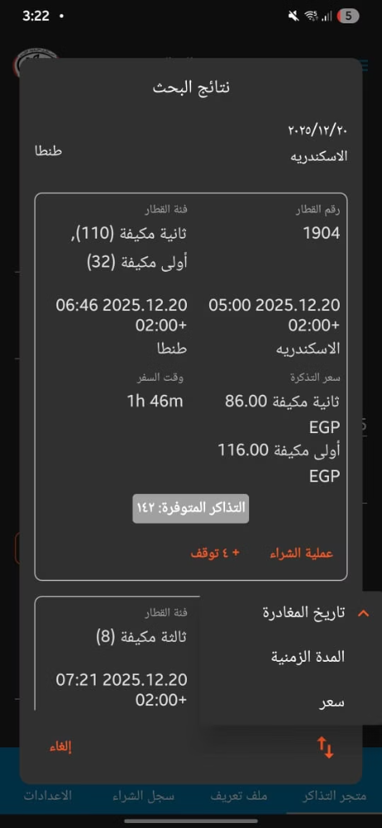
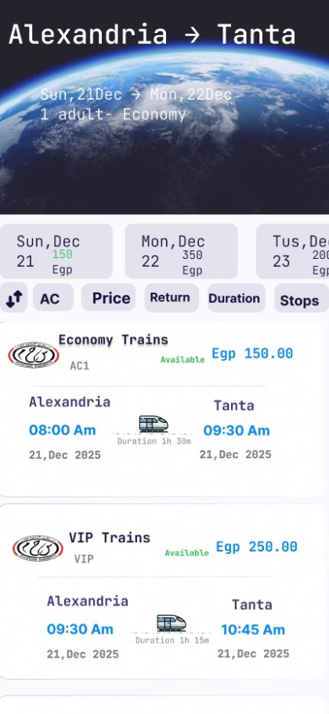
Challenge 5: Empowering Users with Efficient Search Results
The previous iteration of the ENR app presented a cluttered and unoptimized search results page, which frequently overwhelmed users and prolonged the decision-making process.
The Problem: Information Overload
Our Redesign: Precision and Control
Disorganized display of train options, making comparisons difficult.
We introduced robust tools to help users quickly find their ideal train:
Complete absence of sorting capabilities (e.g., by price, duration).
Sorting Options: Allowing users to sort results by price (ascending/descending) and duration (shortest/longest).
Lack of filtering options, forcing users to manually sift through irrelevant results.
Comprehensive Filters: Implementing filters for amenities (AC/Non-AC), number of stops, direct/return journeys, and specific travel dates.
The Benefit: Faster Ticket Selection, Enhanced User Satisfaction
These enhancements transform the search experience, enabling users to efficiently locate and select the most suitable train tickets with minimal effort, significantly improving satisfaction and reducing booking time.

Slide 11

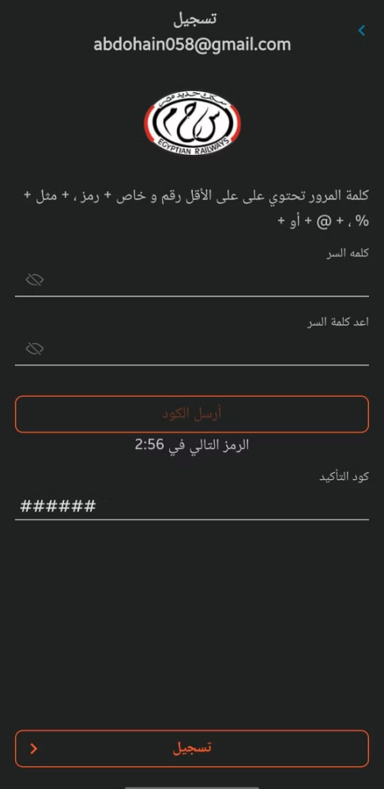
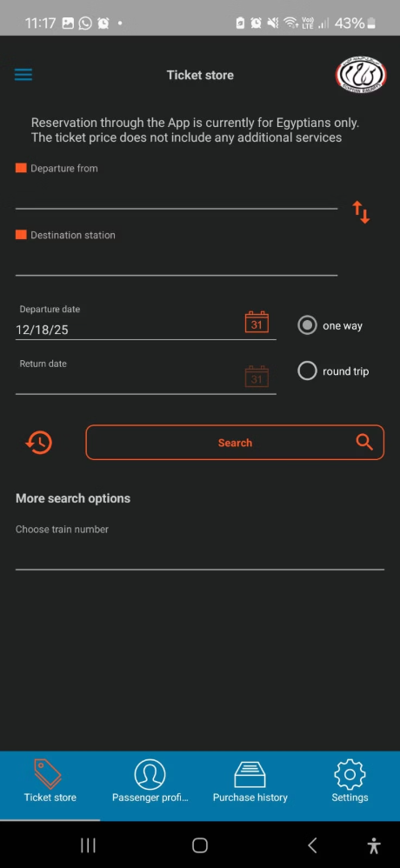

Application Before Redesign:

Slide 12
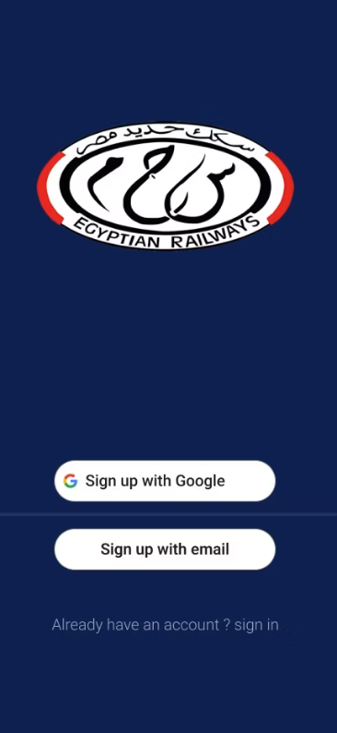

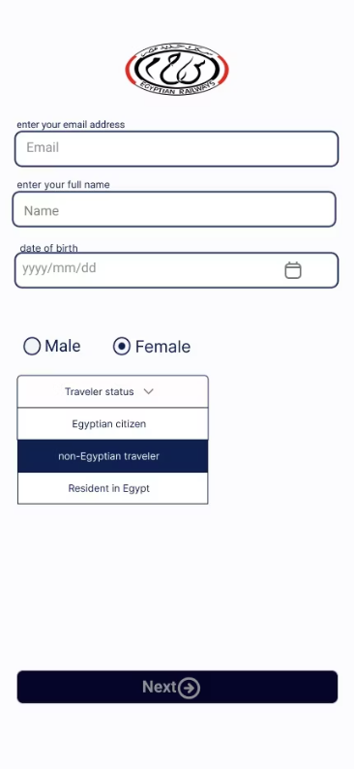

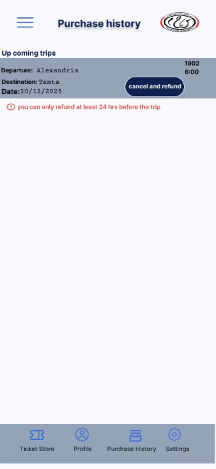
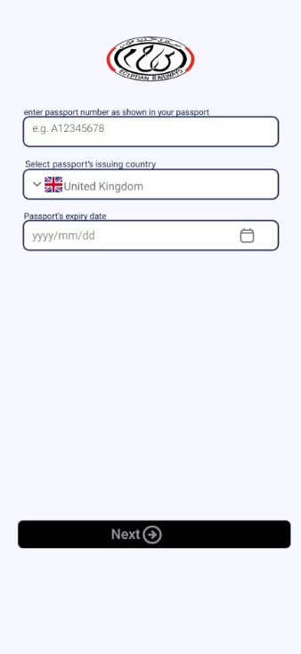
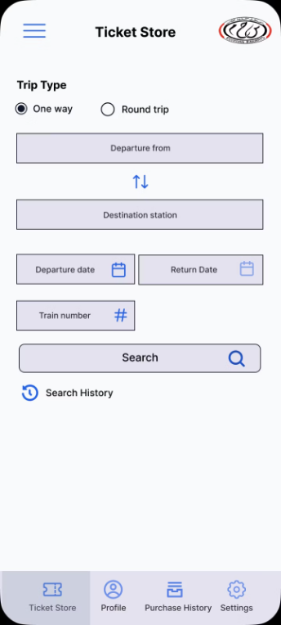

Application After Redesign:

